Slide 1
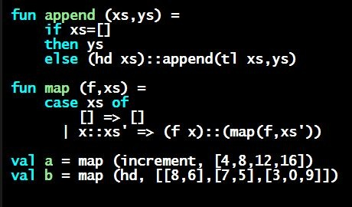
Programming Languages Dan Grossman University of Washington
Why Part A, Part B, Part C

Slide 2
One Course in 3 Parts
100-200 hours of amazing stuff
“My novel” that I can’t bear to think of broken up
Cross-cutting themes
Neat things that tie together later
Key contrasts that come only at the end
A lot of thought in what to include and what not to
I really want you to do all 3 parts
(Certificates priced accordingly)
When I say “the course”, I usually mean everything
So why break it up…

Slide 3
Reasons for parts
Overall, much more material and more challenging than “most MOOCs”
Give you tough-but-intermediate goals that deserve recognition
Give you a chance to “rest” before proceeding
Closer approximation to “different paces”

Slide 4
How it breaks down
Unfortunately “by language” when that’s not the point
Part A is roughly as much as Part B and Part C combined
No natural place to sub-divide Part A in my opinion
Part A: 3 homeworks, 1 exam
Part B: 2 homeworks (1 more challenging)
Part C: 2 homeworks (1 more challenging), 1 exam

